Slide 1

CSS Unit
Absolute Unit:- cm mm inch px pt pc
Relative Unit:- em ( relative direct parent )
rem ( relative to root )
vh ( 1% of viewport height)
vw (1% of viewport width
% (relative to parent element )p)arent)
Note:- h1 = 2rem
h2 = 1.5rem
h3 = 1.17rem
h4 = 1em = 16px
h5 = .83rem
h6 = .67rem

Slide 2
Type of CSS
Inline CSS
Internal CSS
External CSS

Slide 3
Inline CSS
<h1 style="font-size: 15px; color: red;">
Welcome to Our Page A Doctor's Diary.
</h1>

Slide 4
Internal CSS
<html> <head>
<style>
h1 {
color: red;
font-size: 15px;
}
</style>
</head>
<body>
<h1>welcome to Our Pagr A Doctor's Diary.</h1>
</body>
</html>

Slide 5

External CSS
style.css
<head>
<link rel="stylesheet" href="style.css" type="text/css">
</head>

Slide 6
CSS Selector
Element
Id
Class
Attribute
Decedent
Child

Slide 7
Element selector
h1{
color: red;
}
p{
font-size: 15px;
}
<h1> Welcome to Our Page A Doctor's Diary. </h1>
<p> M.S.Prince </p>

Slide 8
Id and class selector
.main{ /* css property */ }
.main2{ /* css property */ }
.main3{ /* css property */ }
#main{ /* css property */ }
<h1 class="main main2 main3">
welcome to Our Pagr A Doctor's Diary.
</h1>
<p id="main"> M.S.Prince </p>

Slide 9
Attribute Selector
li[data-category="fruit"] {
color: red;
}
li[data-category="vegetable"] {
color: green;
}
<ul>
<li data-category="fruit"> Apple </li>
<li data-category="vegetable"> Carrot</li>
<li data-category="fruit"> Orange </li>
<li data-category="vegetable"> Broccoli </li>
</ul>

Slide 10
Decendent Selector
.container p {
color: blue;
}
.container li {
color: green;
}
<div class="container">
<h2> Title </h2>
<p>This is a paragraph inside the container.</p>
<ul>
<li>Item 1</li>
<li>Item 2</li>
</ul>
</div>

Slide 11
Child Selector
.parent > p {
color: blue;
font-weight: bold;
}
<div class="parent" >
<p> This is a paragraph inside the parent div. </p>
<span> This is a span inside the parent div. </span>
<div class="child">
<p> This is a paragraph inside the child div. </p>
</div>
</div>

Slide 12
Pseudo-Classes
:link
:visited
:hover
:active
:first-child
:last-child
:n^{th}-child
example
example
example

Slide 13
Pseudo-elements
::first-letter
::first-line
::before
::after
::selection
::marker
example

Slide 14
Important
Comment
/* p {
color: pink;
} */
.child { color: pink, !important;
}
Opacity
.main {
opacity: 0-1;
}

Slide 15
CSS Color
color: pink;
color: rgb(138, 255, 0);
color: rgba(138, 255, 0, 0.9);
color: hsl(hue, saturation, lightness);
color: hsla(hue, saturation, lightness, alpha);
HSL(11, 80%, 60%, 0.6);
color: #rrggbb

Slide 16
Color-gradient
.css-gradient {
background-image: linear-gradiant(red, blue, pink);
background-image: linear-gradiant(to right red, blue, pink);
background-image: linear-gradiant(to bottom red, blue, pink);
background-image: linear-gradiant(120deg red, blue, pink);
background-image: radial-gradiant(red, blue);
background-image: radial-gradiant(red, blue, pink);
background-image: radial-gradiant(circle red 20%, blue 30%, pink 50%);
}

Slide 17
CSS Background
background-color: aqua;
background-image: url("pooja.jpg") , url("puggul.jpg");
background-repeat: no-repeat / repeat / repeat-x / repeat-y ;
background-position: left top / right bottom /.....;
50px 100px ;
5% 10% ;
background-size: contain / cover ;
50% 60% ;
background-attachment: scroll / fixed ;
background-origin: border-box / padding-box / content-box ;
background-clip: ;

Slide 18
CSS Border
border-width: 2px ;
border-style: dotted / dashed / solid / double ;
background-color: lightgrey ;
border: 2px solid red;
border-bottom: 10px solid red;
border-top: px dotted black;
border-left: 10px solid red;
border-right: 3px dotted black;

Slide 19
CSS Border
border-radius: 10px 30px ;
4px ;
5px 6px 3px ;
5px 8px 2px 3px ;
border-top-left-radius: 2px ;
border-top-right-radius: 3px ;
border-bottom-left-radius: 5px ;
border-bottom-right-radius: 10px ;

Slide 20

CSS Outline
border: 10px solid green;
outline: 10px solid red;
outline-offset: 10px;

Slide 21
CSS Padding
No –ve value
div{
padding: 3px 2px 5px 1px ;
3px 4px 2px ;
6px ;
4px 8px ;
padding-top: ;
padding-right: ;
padding-bottom: ;
padding-left: ;
}
M.S.Prince

Slide 22
CSS Margin
–ve value allowed
div {
margin: ;
margin-top: ;
margin-right: ;
margin-bottom: ;
margin-left: ;
}
M.S.Prince

Slide 23
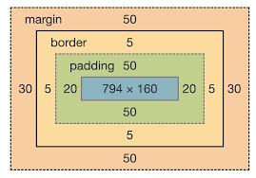
CSS Box model
top
left
right
bottom
Total element width:-
Total element height:-

Slide 24
CSS box-sizing
.box-sizing {
box-sizing: border-box ;
box-sizing : content-box ;
}
Initial & Inhirit
By default
Parent properity

Slide 25
CSS Height & Width
div{
max-width: ;
min-width: ;
max-height: ;
min-height: ;
}
% or px or vw or vh

Slide 26
Image-filter
.image-filter {
filter: blur(10%);
filter: brightness(10%);
filter: contrast(10%);
filter: drop-shadow(5px 5px 6px pink);
filter: gray-scale(10%); /* for white */
filter: hue(10deg);
filter: invert(10%);
filter: opacity(10%);
filter: saturate(10%);
filter: sepia(10%);
}

Slide 27

Image-sprites
.image-sprites {
height: 128px;
background-image: url("pooja.jpg");
background-repeat: no-repeat;
background-position: 0px -143px;
0px -288px;
}

Slide 28
CSS Font
Google font link
Fall back font
div{
font-size: rem or px;
font-weight: 100-900; bold / bolder / regular ;
font-style: italic;
font-variant: small-caps;
font-family: Verdana, Geneva, Tahoma, sans-serif...;
}

Slide 29
CSS Text
color: ;
text-align: left / center / right / justify;
direction: rtl ;
vertical-align: center / top / bottom;
text-decoration: underline / overline / none / line-through ;
text-transform: uppercase / lowercase / capitalize;
line-height: 30px ;
text-indent: 5px;
letter-spacing: 8px;
word-spacing: 10px;

Slide 30
CSS Text
white-space: normal / pre / nowrap;
word-wrap: break-word ;
text-shadow: 5px 6px 8px red;
writing-mode: vertical-rl / vertical-lr;
div {
overflow: hidden;
text-overflow: ellipsis;
clip; default
}
My name is M.S.Prince ……

Slide 31
box-shadow
box-shadow: h-offset v-offset blur spred-radius color
.box-shadow {
box-shadow: 0px 2px 5px 6px #ccc;
box-shadow: 0px 2px 5px 6px #ccc inset ;
box-shadow: 0px 2px 10px 2px #0cc474 inset , -2px -3px 4px 5px red ;
}

Slide 32
CSS Overflow & Resizable
.css-overflow {
overflow: visible / hidden / scroll / auto;
overflow-x: ;
overflow-y: ;
resize: both / none / vertical / horizontal;
}

Slide 33
float & clear
float : none / left / right / initial / inhirit / ;
clear: none / left / right / inline-start /
inline-end / initial ;

Slide 34
CSS Link
a:link { color: pink; }
a:visited { color: rgb(212, 6, 40); }
a:hover { color: rgb(10, 42, 187); }
a:active { color: rgb(19, 216, 170); }

Slide 35
CSS Cursor
.container {
cursor:
auto
all-scroll
cell
col-resize
crosshair
e-resize
help
not-allowed
pointer
progress
wait
zoom-in
zoom-out;
}

Slide 36
List-Style
ul {
list-style-type: disc / none / circle / square;
list-style-image: url(“ ");
list-style-position: outside / inside;
}
ol {
list-style-type: upper-alpha / lower-alpha / lower-roman /
upper-roman / decimal / decimal-leading-zero;
list-style-position: outside / inside;
list-style-image: url(“ ");
}

Slide 37
column count
div {
column-count: ;
column-width: ;
column-gap: ;
column-rule: ;
column-span: ;
column-rule-width: ;
column-rule-style: ;
column-rule-color: ;

Slide 38
display
visibility
div {
display: inline
block
contents
flex
grid
none
}
div {
visibility: visible
hidden
collapse;
}

Slide 39
CSS Function
div {
width: cal(100% - 100px);
}
:root {
--primary-color: pink;
--secondary-color: red;
--bg-color: light-green;
}
div {
background-color: var(--bg-color);
}

Slide 40
Position
div {
position: static;
relative;
fixed;
absolute;
top: 3px;
bottom: 4px;
left: 6px;
right: 9px;
}
By default
From current position & do not overcome anybody on his own place
left his own place and allow to anybody come on his own place.
According to positioned parent ( accept static ) , left his own place and allow to anybody come on his own place.

Slide 41
Layers & Z index
1
div {
z-index:1 ; any value
}
3
2
Z –index वही लागते है जहा position properity लगी हो absolute , fixed, relative में से कोई एक

Slide 42


2D Transform
Block element
Normally hover pr hi lgate hai
Inline-block
Inline element
div {
transform: translate();
translateX();
translateY();
scale();
scaleX();
scaleY();
skew();
skewX();
skewY();
rotate();
rotateX('angle');
rotateY('angle');
}
div {
transform: skew();
skewX();
skewY();
rotate();
rotateX('angle');
rotateY('angle');
transform-origin: 5 7
50% 50%
0 100%;
}
Normally center se hota hai

Slide 43
3D Transform

Slide 44
Transition
Hover pr jis properity me effect change karna ho ho uske liye
div {
transition-property: all width height...... ; /* jis properity ko change karna ho */
transition-duration: 5s;
transition-delay: 3s;
transition-timing-function: ease-in
ease-out
ease-in-out;
transition: property duration timing-function delay;
}

Slide 45
Animations
/* Apply the animation to an element */
.element-to-animate {
animation-name: exampleAnimation;
animation-duration: 3s;/* Animation duration */
animation-timing-function: ease;/* Timing function */
animation-delay: 1s;/* Delay before the animation starts */
animation-iteration-count: infinite;/* Number of times the animation should repeat */
animation-direction: alternate;/* Direction of animation */
animation-fill-mode: forwards;/* Animation fill mode */
}

Slide 46
@keyframes exampleAnimation {
0% {
/* Initial state of the element */
transform: scale(1);
opacity: 1;
color: red;
/* Add other properties you want to animate here */
}
50% {
/* Intermediate state of the element */
transform: scale(1.5);
opacity: 0.5;
color: blue;
/* Add other properties you want to animate here */
}
100% {
/* Final state of the element */
transform: scale(1);
opacity: 1;
color: red;
/* Add other properties you want to animate here */
}
}

Slide 47
Print Style
@media screen{
p{
font-size: 15px;
}
img{
display: none;
}
body{
background-color: black;
}
}
@media print{
p{
font-size: 15px;
}
img{
display: none;
}
body{
background-color: black;
}
}

Slide 48
Responsive Web Design

Slide 49
meta tag
<head>
<meta charset="UTF-8">
<!-- Setting the viewport to make your website look good on all devices: -->
<meta name="viewport" content="width=device-width, initial-scale=1.0">
<!--Define a description of your web page: -->
<meta name="description" content="Free Web tutorials">
<!--Define keywords for search engines: -->
<meta name="keywords" content="HTML, CSS, JavaScript">
<!--Define the author of a page:-->
<meta name="author" content="John Doe">
<!-- Refresh document every 30 seconds: -->
<meta http-equiv="refresh" content="30">
</head>

Slide 50
Media Queries

Slide 51
CSS Specificity

Slide 52
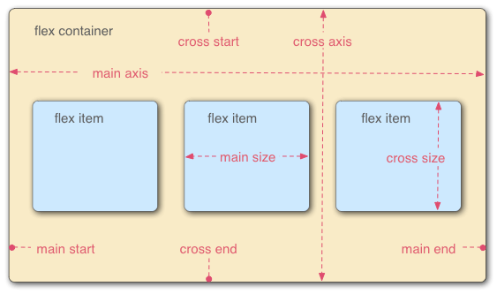
Flexbox
.flex-container{
}
.flex-item{
}

Slide 53
flex
.flex-container{
display : flex;
Flex-direction: row \ row-reserve \ column \ column-reserve;
gap: ;
Flex-wrap: wrap \ no-wrap \ wrap-reserve ;
Flex-flow: ;
Justify-content: flex-start / flex-end /center /space-around /
space-between / space- evenly;
Align-items: stretch / center / flex-start / flex-end /
start /end / baseline / inhirit;
Align-content: flex-start / flex-end / space-around /
space-between / space-evenly;
}
height width na de to jagah ke according space adjust kar lega
According to main axis
According to cross axis
This property arranges flex-items along the CROSS AXIS inside the flex-container. This is similar to justify-content.

Slide 54
flex
.flex-item{
Order: 0 default
Flex-grow: 1 default
Flex-shrink: 1 default (when overflow)
Flex-basis:
Align-self: flex-start flex-end Center Baseline Stretch auto
}
This is similar to adding width to a flex-item, but only more flexible. flex-basis: 10em, for example, will set the initial size of a flex-item to 10em. Its final size will be based on the available space, flex-grow, and flex-shrink.

Slide 55
Grid & flex
Flex layout
Grid layout

Slide 56
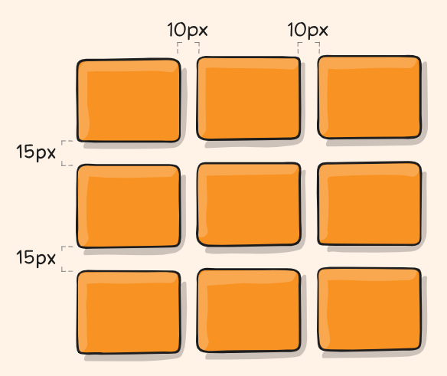
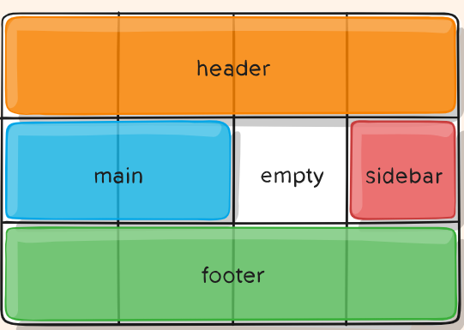
CSS Grid
parent{
display: grid || inline grid;
grid-template-columns: 1fr 1fr || repeat(5, 1fr) || 50px auto 100px 1fr || minmax(10px, 1fr) 3fr ;
grid-template-rows: min-content 1fr min-content || 100px 1fr max-content;
grid-column: ; /*gap*/
grid-row: ; /*gap*/
justify-content: start | end | center | stretch | space-around | space-between | space-evenly;
align-content: start | end | center | stretch | space-around | space-between | space-evenly;;
grid-template-areas: "header header header header"
"main main . sidebar"
"footer footer footer footer";
}
/* x-axis */
/* y-axis */

Slide 57
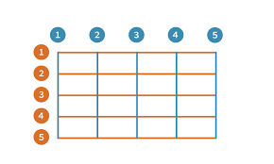
child{
grid-column-start: ;
grid-column-end: ;
grid-row-start: ;
grid-row-end: ;
grid-area: row-start/column-start/row-end/column-end;
1 / 2/ 5/ 8;
1 / 2 / span 4 / span 5;
}
grid-column: 1/5 || 4/7 || 1/span 3 ;
grid-row: 1/5 || 4/7 || 1/span 3 ;
.container {
display: grid;
grid-template-columns: 50px 50px 50px 50px;
grid-template-rows: auto;
grid-template-areas:
"header header header header"
"main main . sidebar"
"footer footer footer footer";
}
item-a {
grid-area: header;
}
.item-b {
grid-area: main;
}
.item-c {
grid-area: sidebar;
}
.item-d {
grid-area: footer;
}

Slide 58
CSS - Validations
Go on gogle & search css validation
Jigsaw.com

